Slide 1
Life Expectancy Data
Tianxing Li, Yaodong Wang, Yao Xiao, Donglai Xu

Slide 2
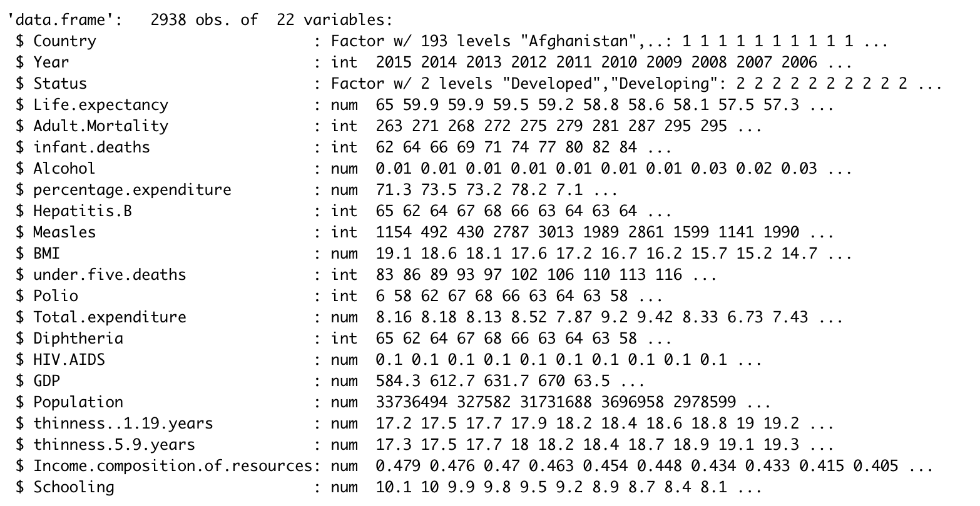
Overview
Country
Year
Status（developing/developed)
Life expectancy
Adult Mortality
Infant deaths
Alcohol
Percentage.expenditure
Hepatitis B
Measles
BMI
under-five deaths
Polio
Total expenditure
Diphtheria
HIV/AIDS
GDP
Population
thinness 1-19 years
thinness 5-9 years
Income.composition.of.resources
Schooling
Track of the health status as well as many other related factors for 193 countries from 2000-2015.

Slide 3
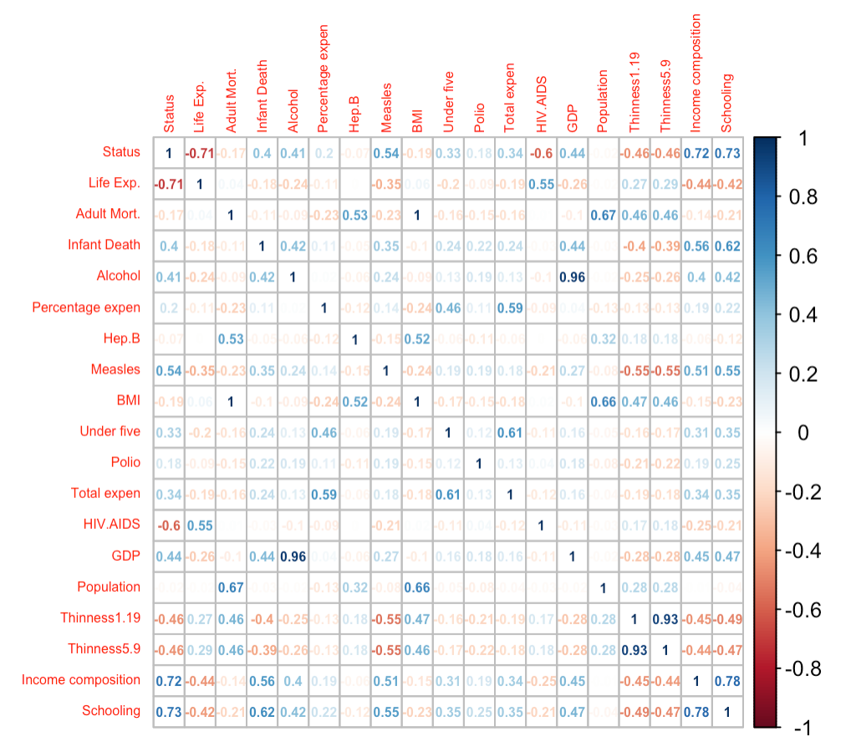

Slide 4
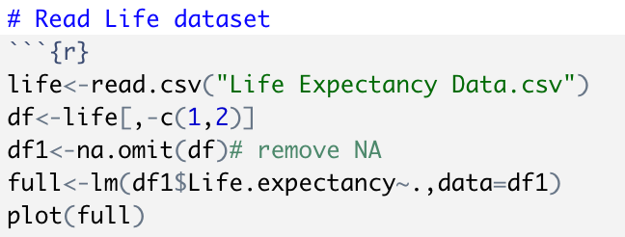
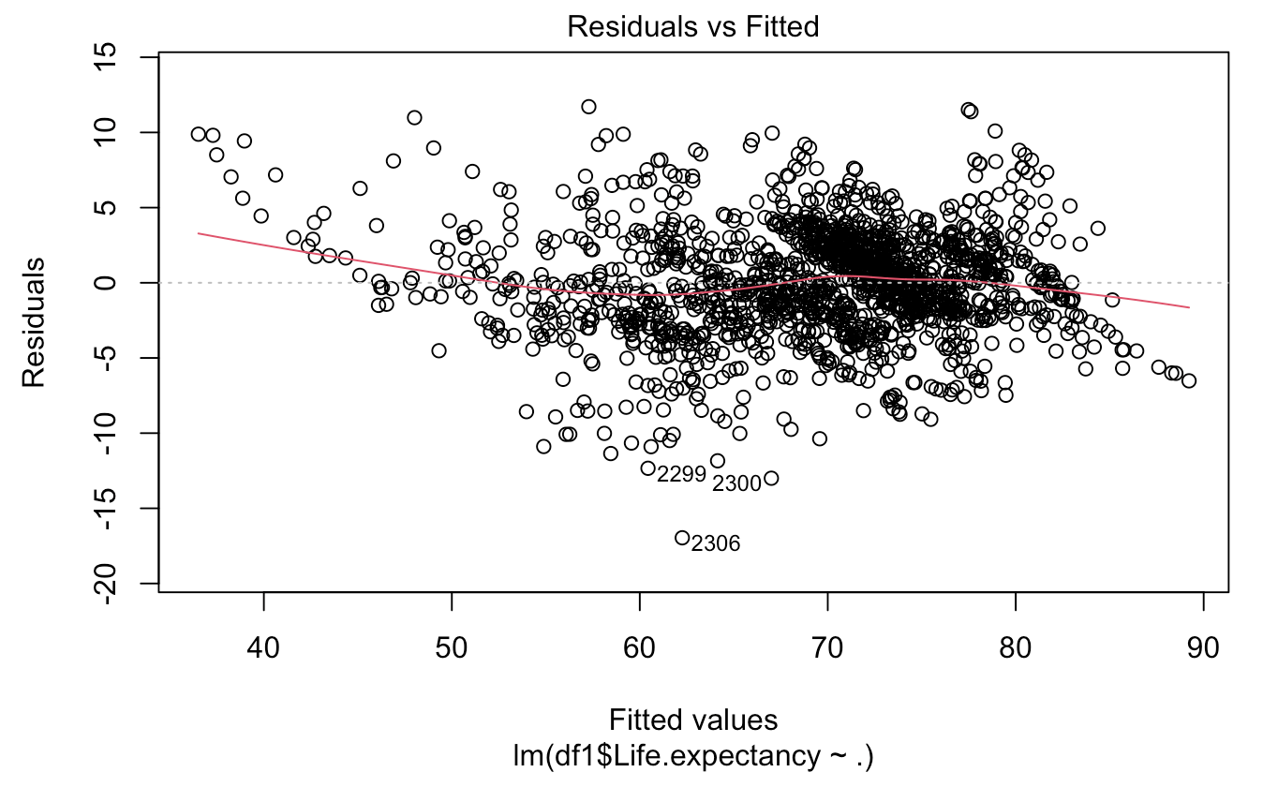
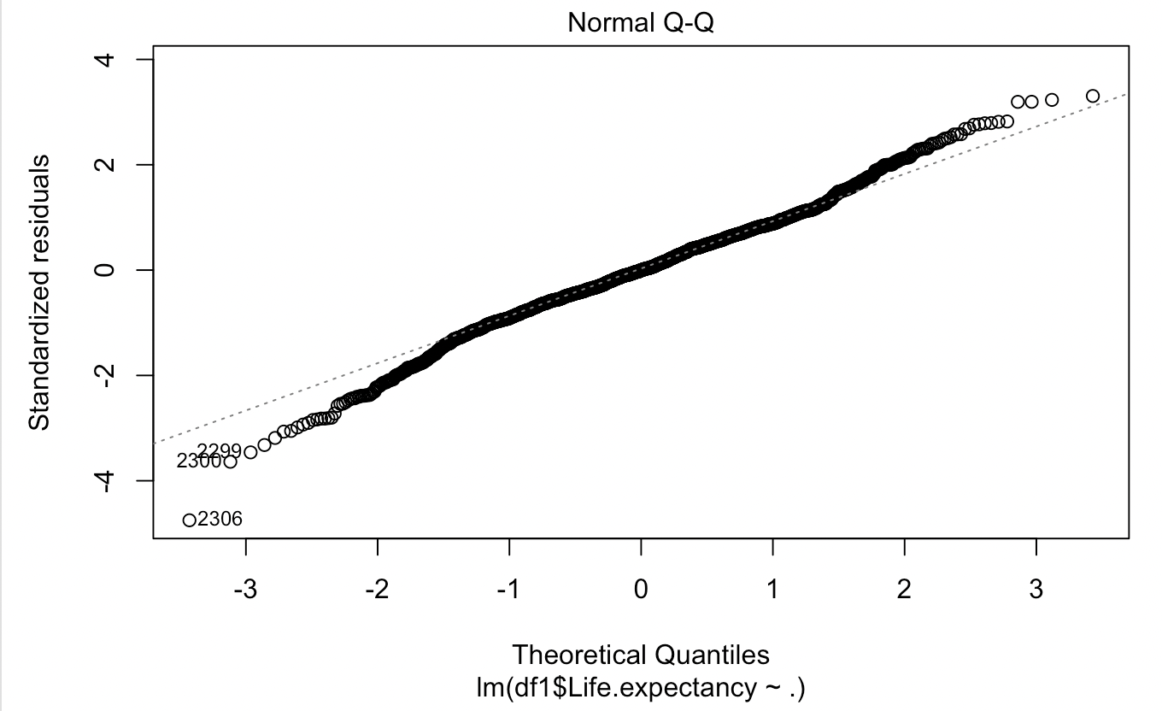
Read life data

Slide 5
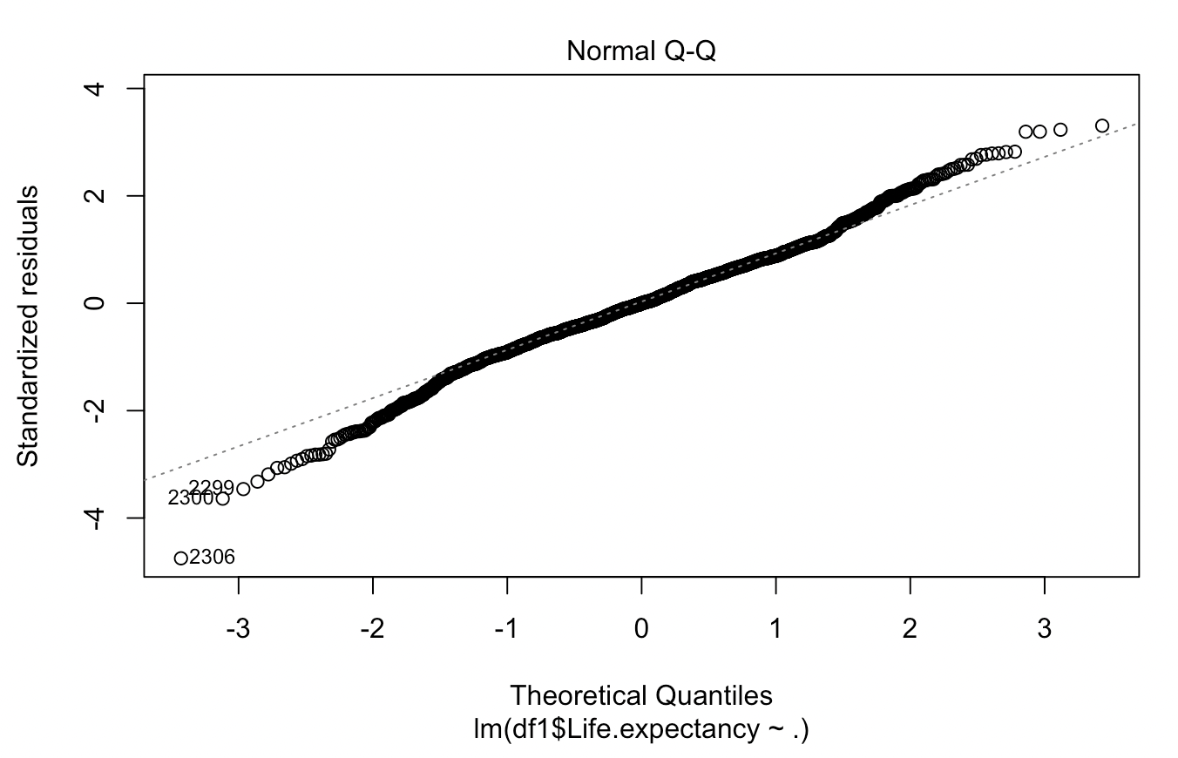
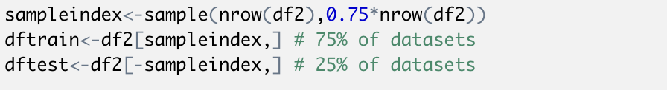
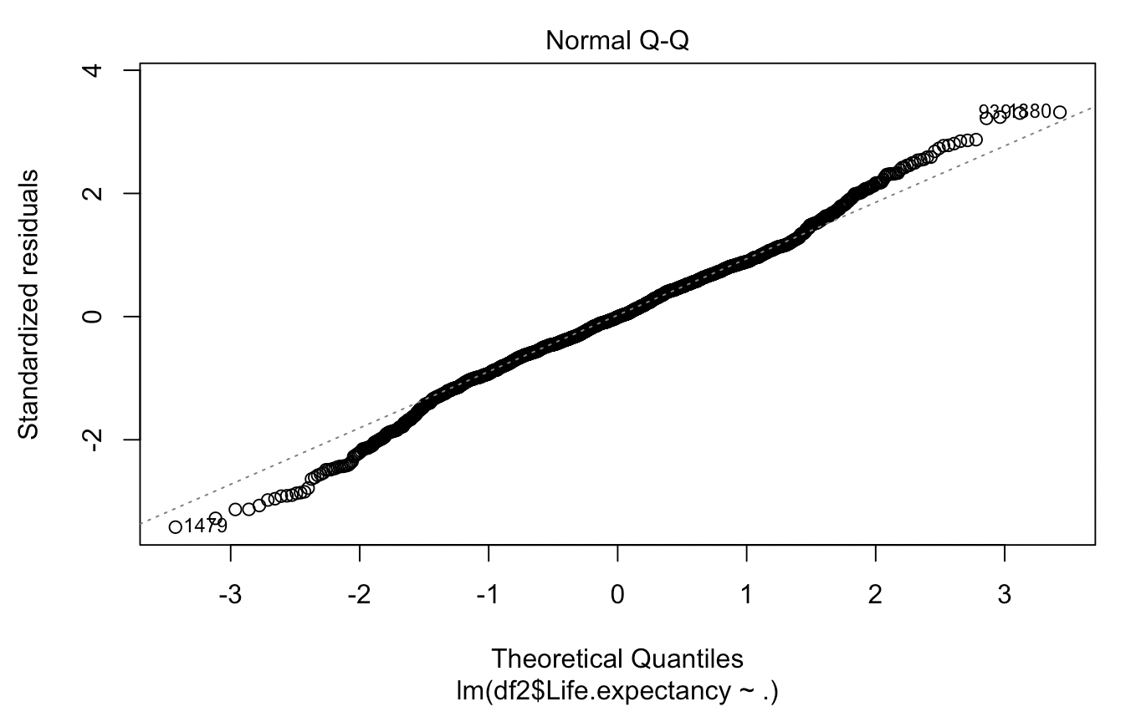

Split datasets into train/test
Remove NA
Convert Categorical variables into Dummy Variables
Remove outliers

Slide 6
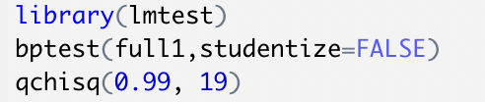
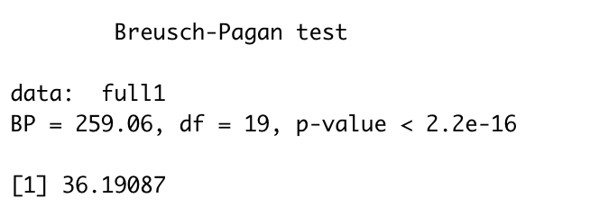
BP test

Slide 7
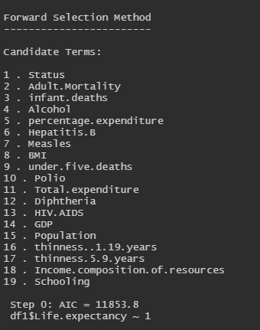

Stepwise Regression
(Forward)

Slide 8
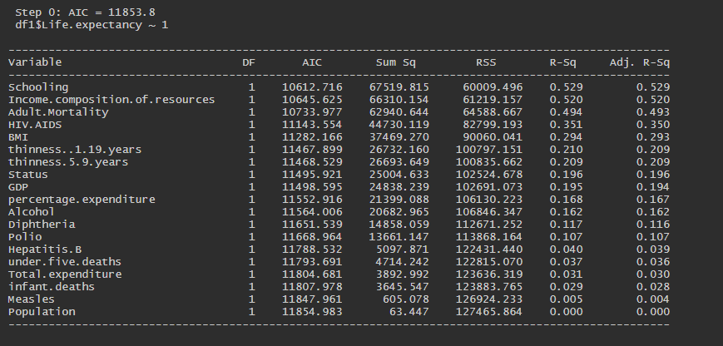
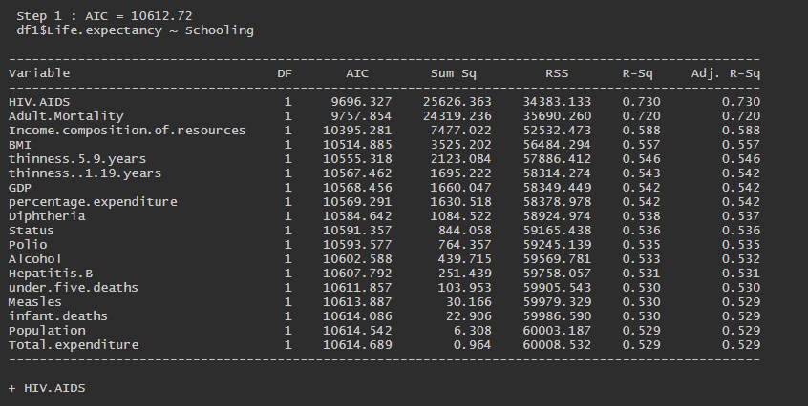

Slide 9
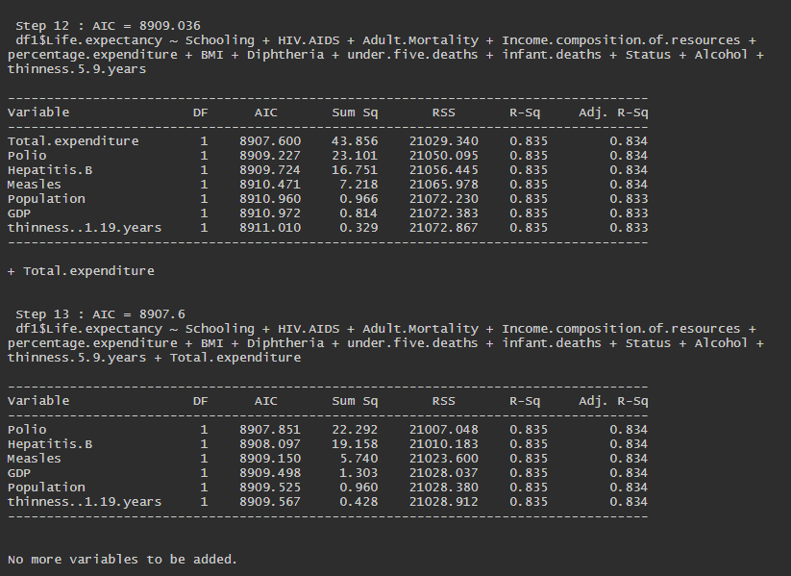
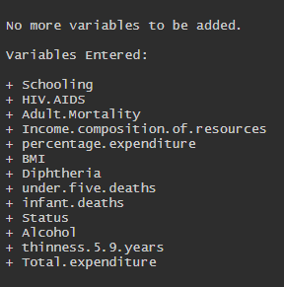

Slide 10
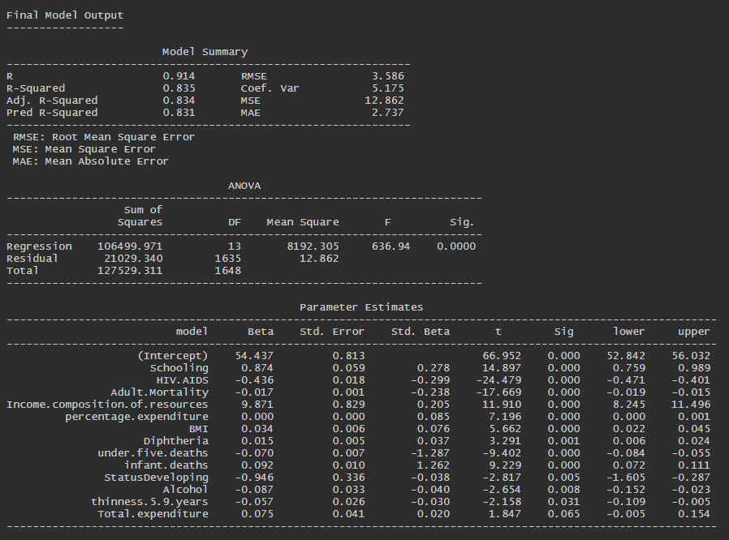

Slide 11

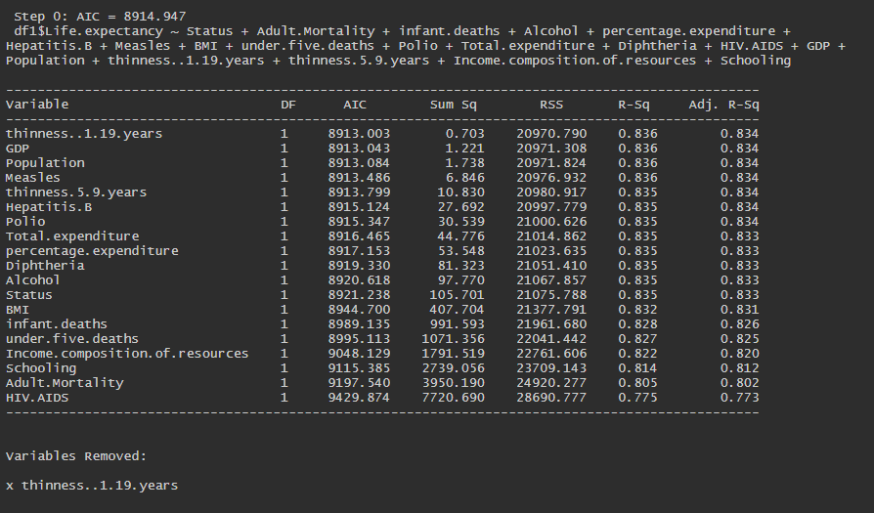
Stepwise Regression
(Backward)

Slide 12
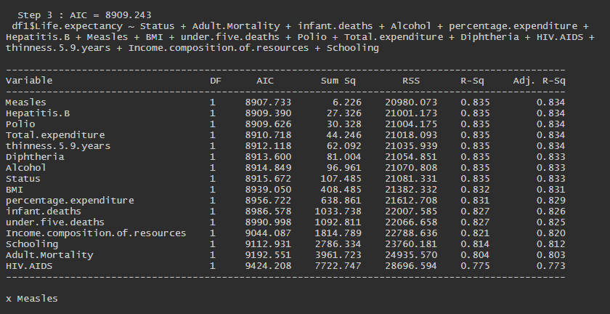
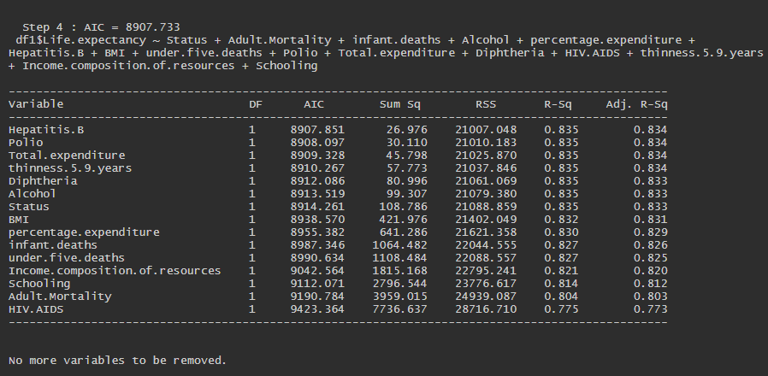

Slide 13
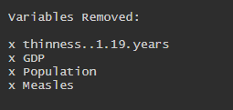
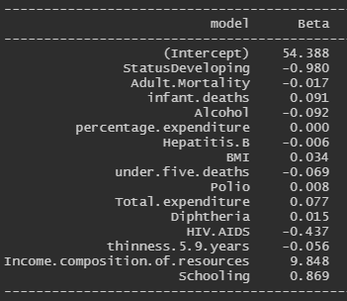
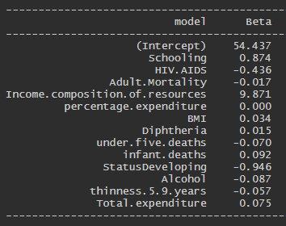

Slide 14
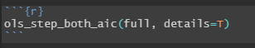
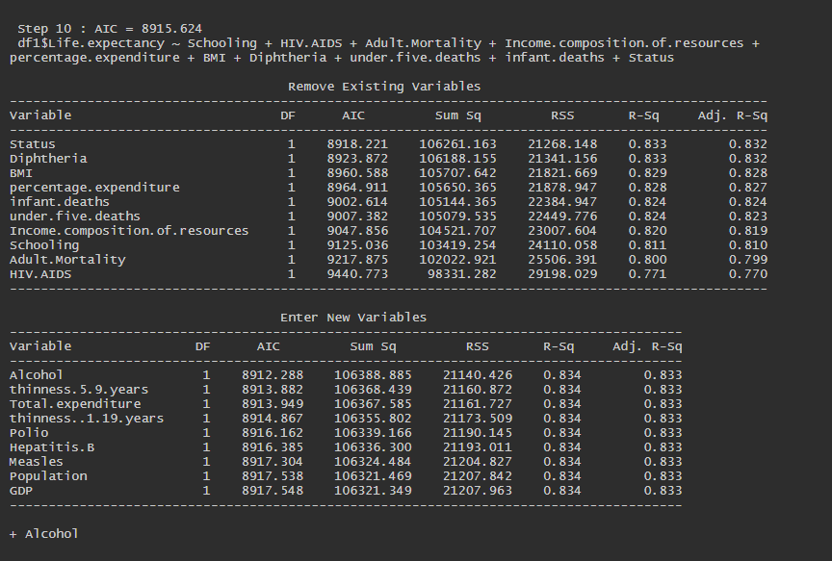
Stepwise Regression
(Both direction)

Slide 15
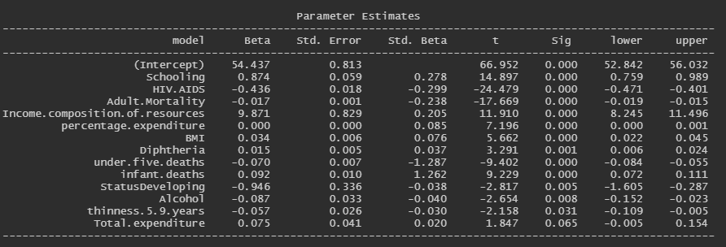
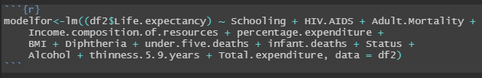

Slide 16
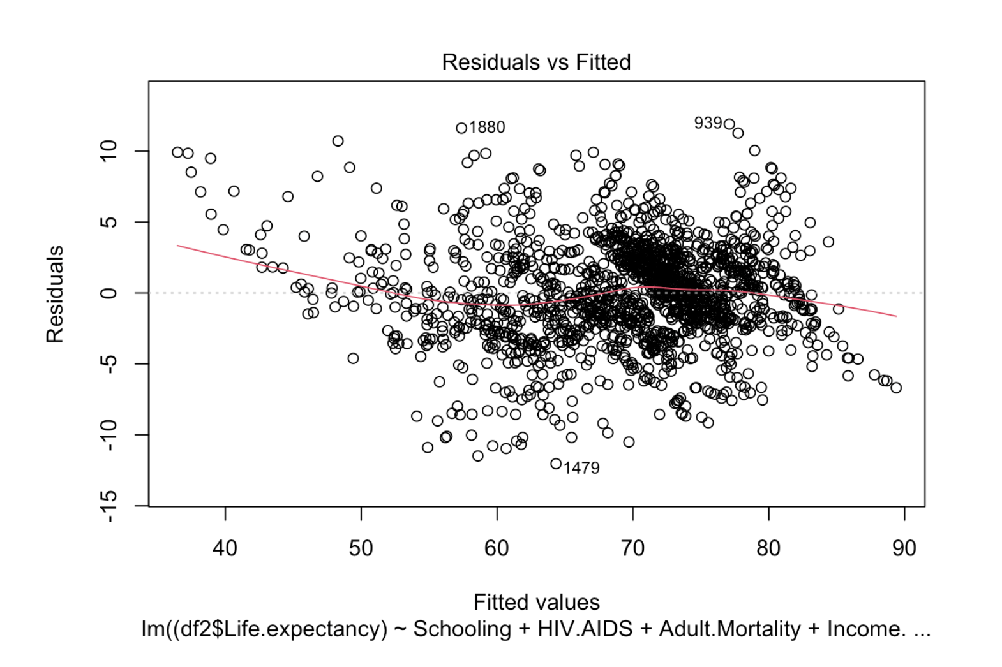
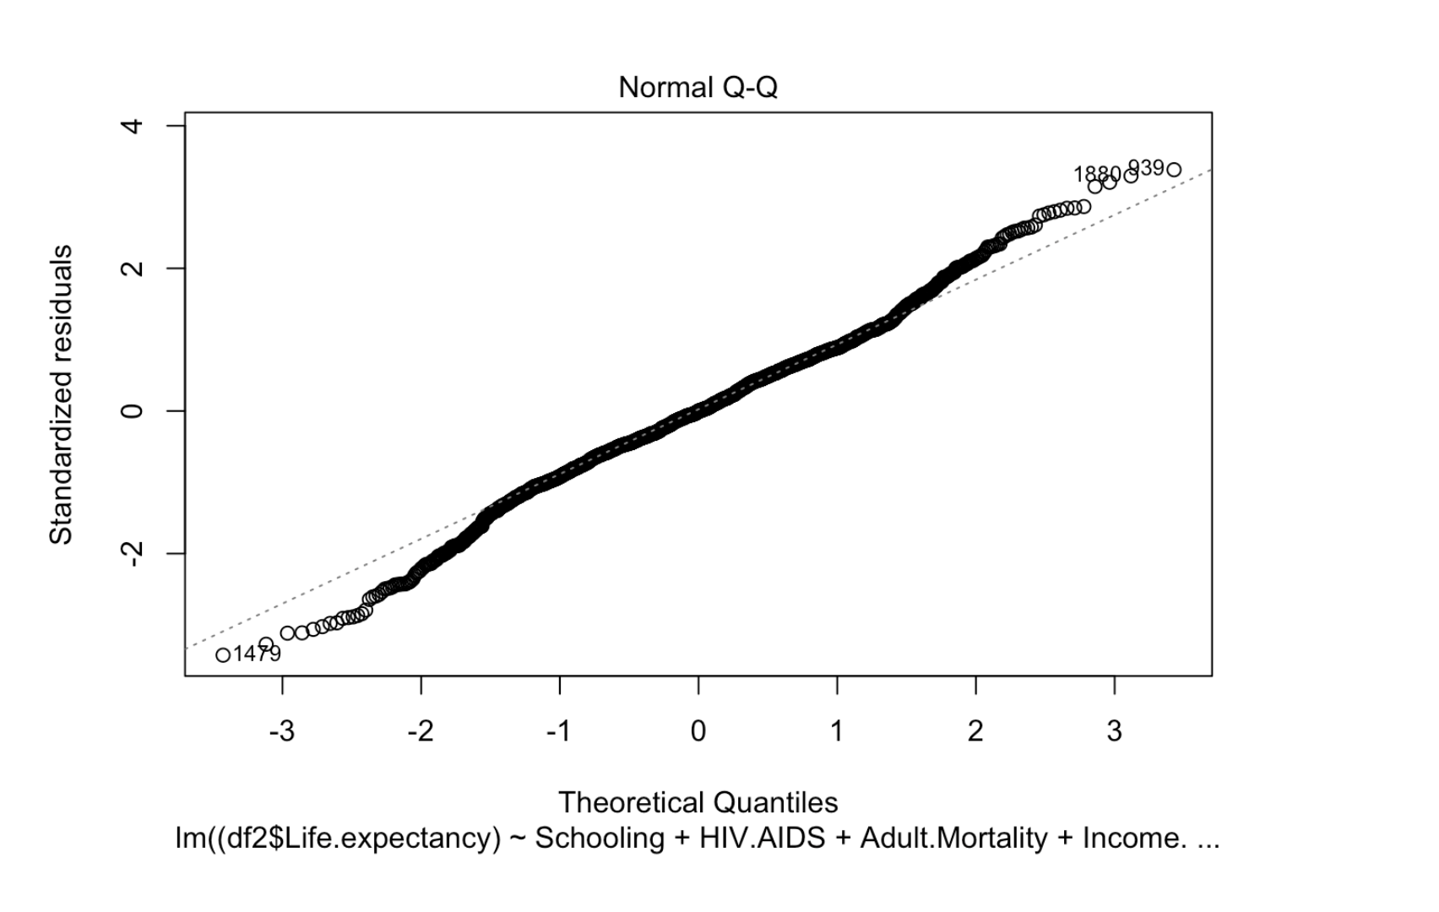
Plots after selection

Slide 17
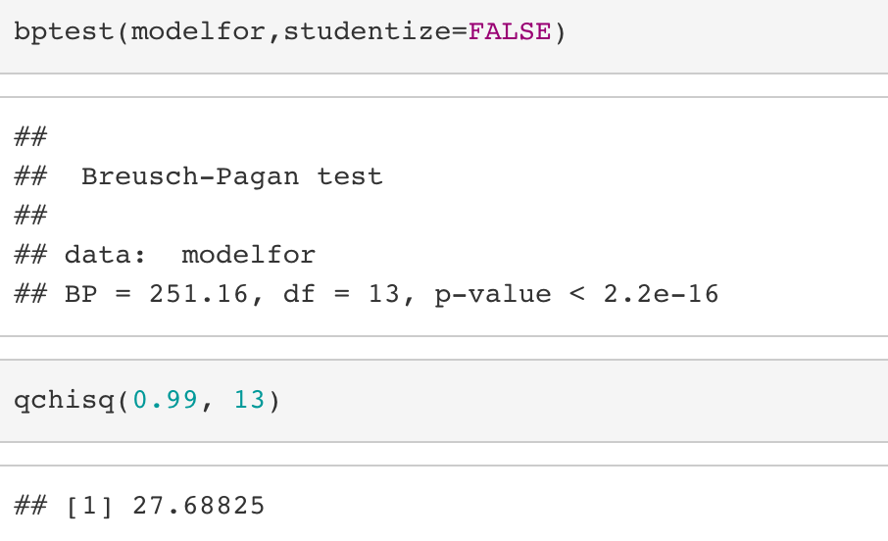
BP Test

Slide 18
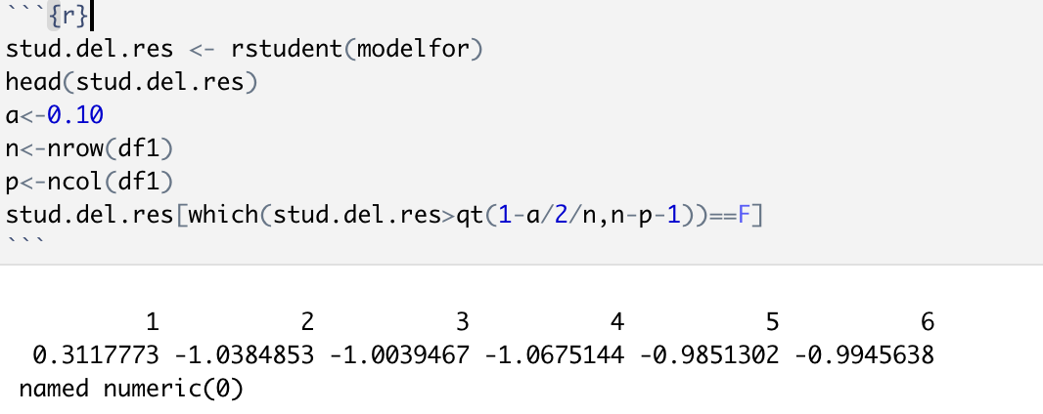
Bonferroni outlier test

Slide 19
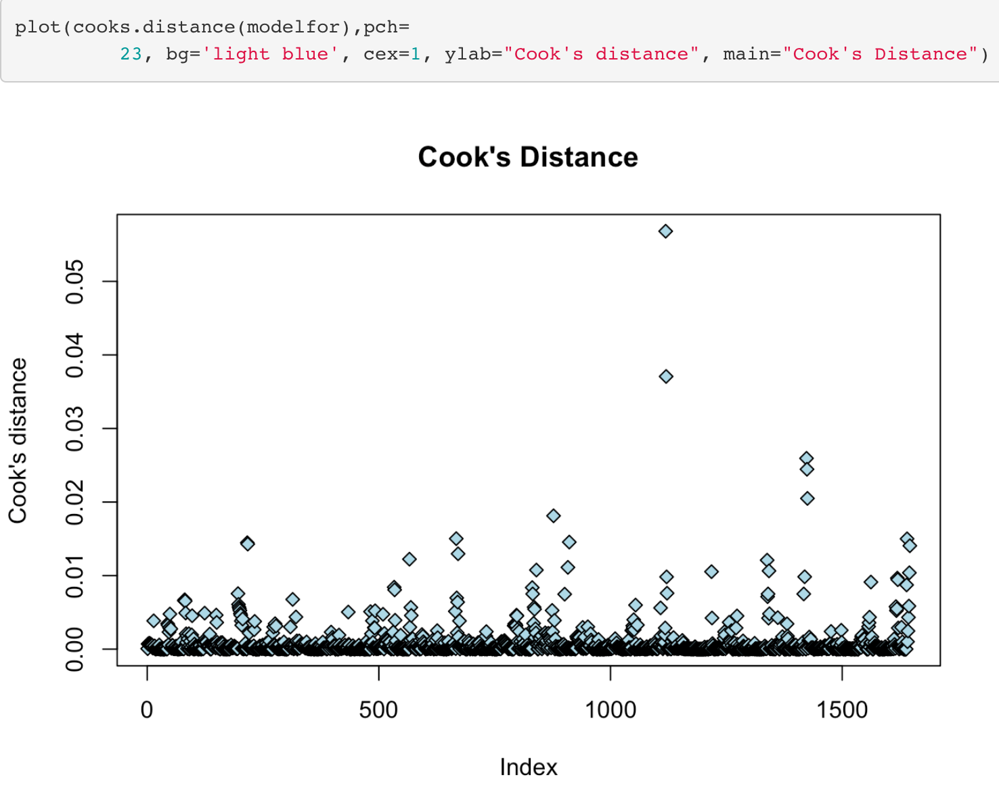
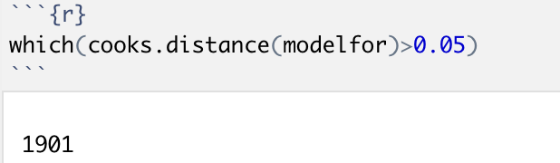
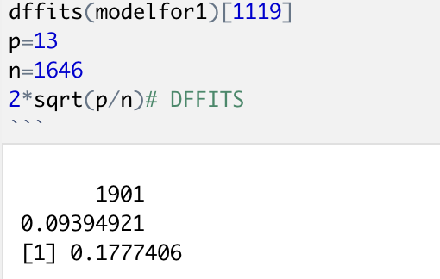
Cook’s distance

Slide 20
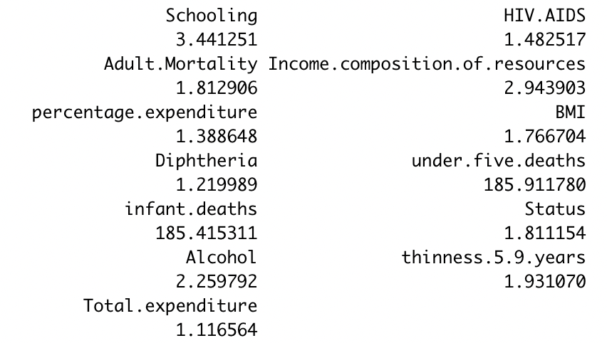
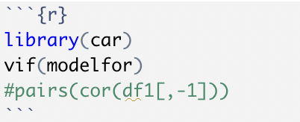
Check VIF

Slide 21
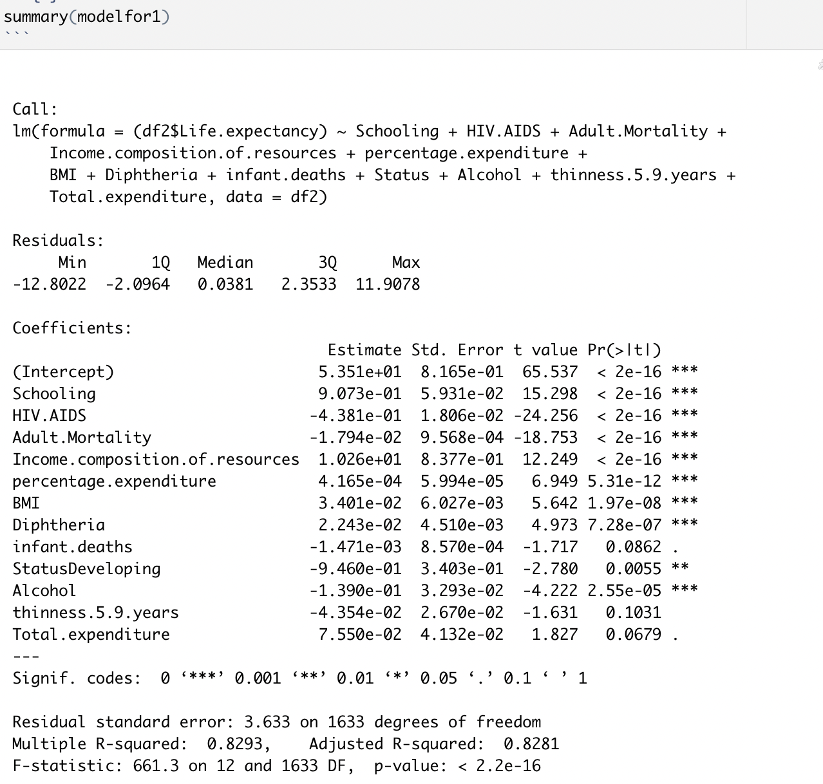
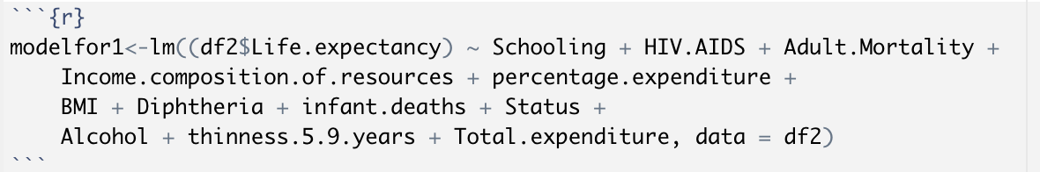
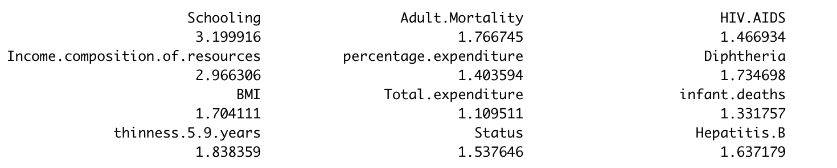
New model
VIF for new model
Notes:
After deleting the predictor under.five.death, all of the VIF score are smaller than 4.
They both have large VIF score and they are highly correlated with each other. This makes sense, since under.five.death means Number of under-five deaths per 1000 population, infant.death means Number of Infant Deaths per 1000 population. They are similar to each other.

Slide 22
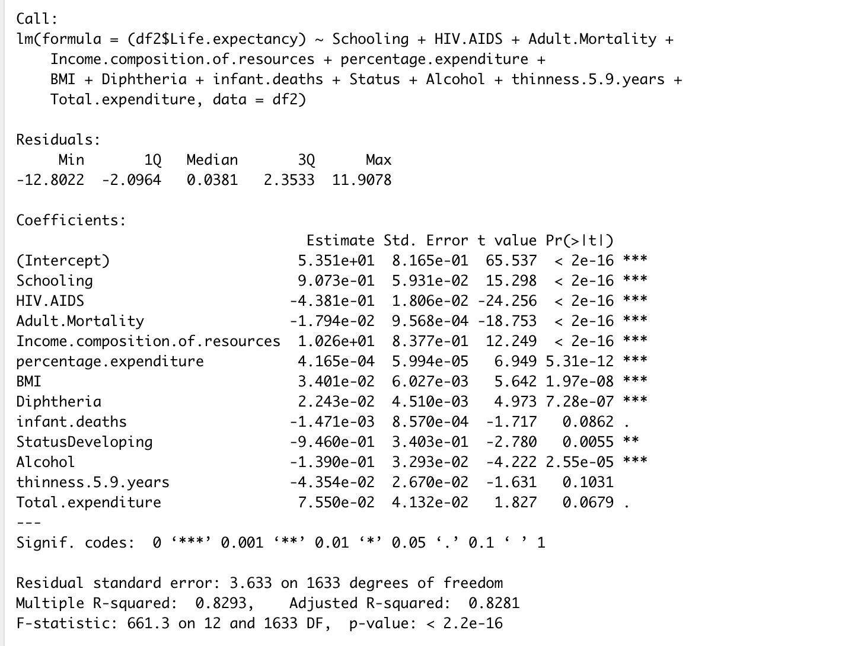
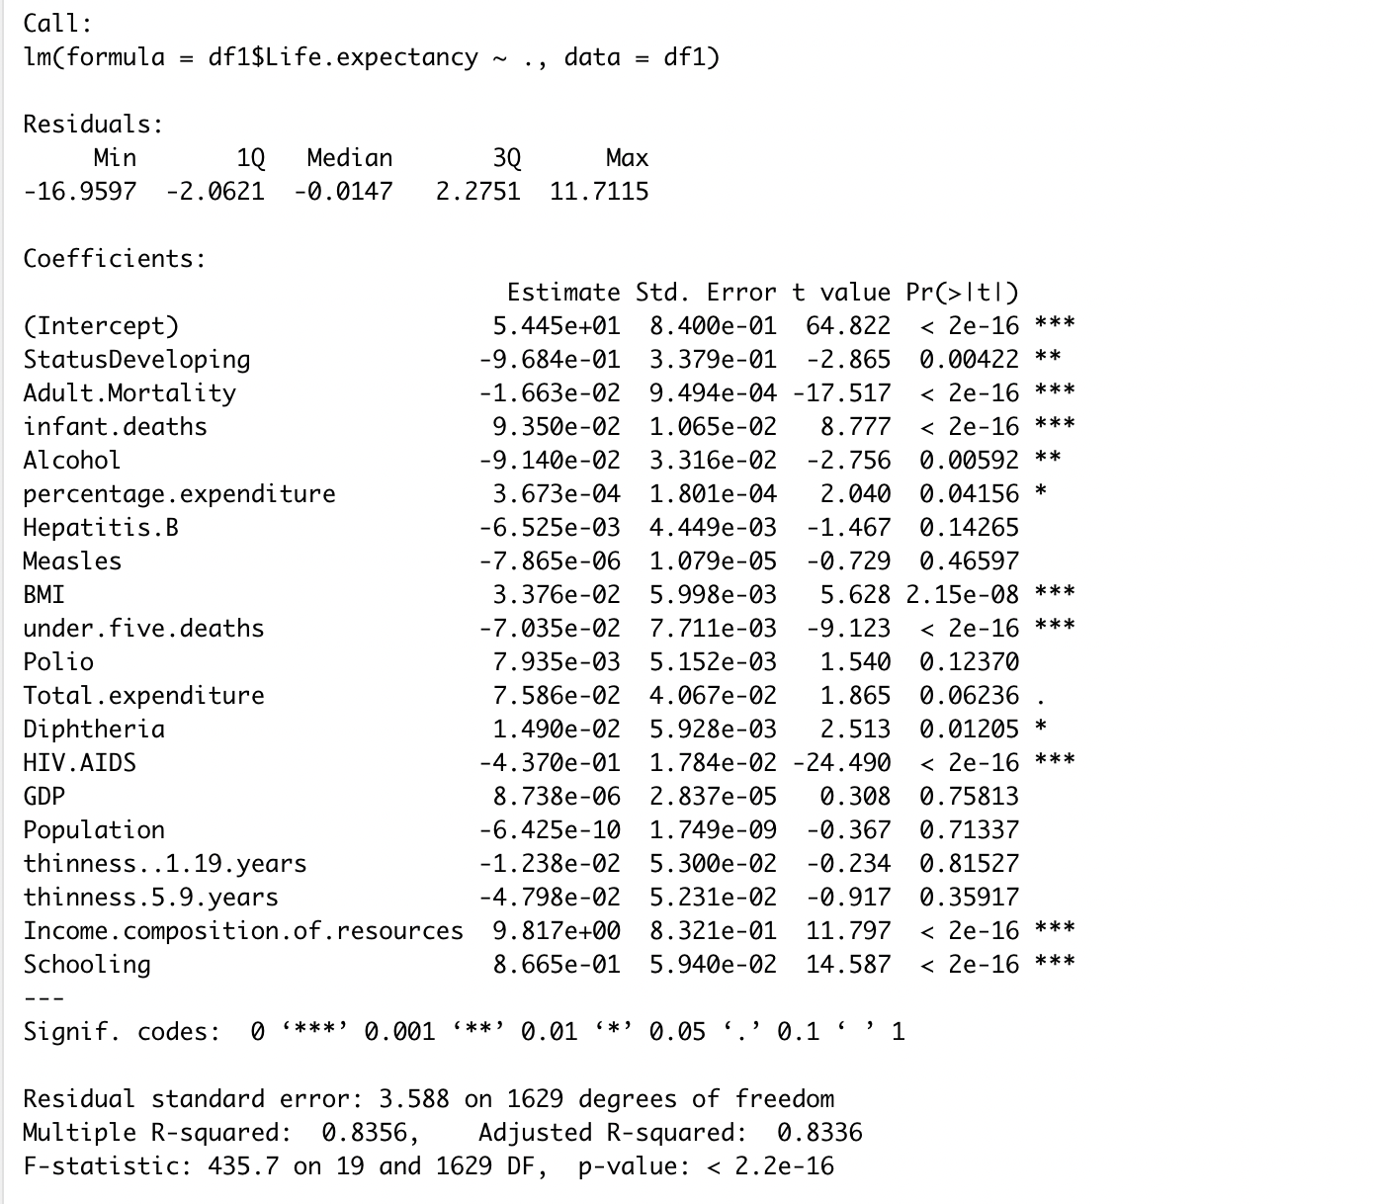
Summary

Slide 23
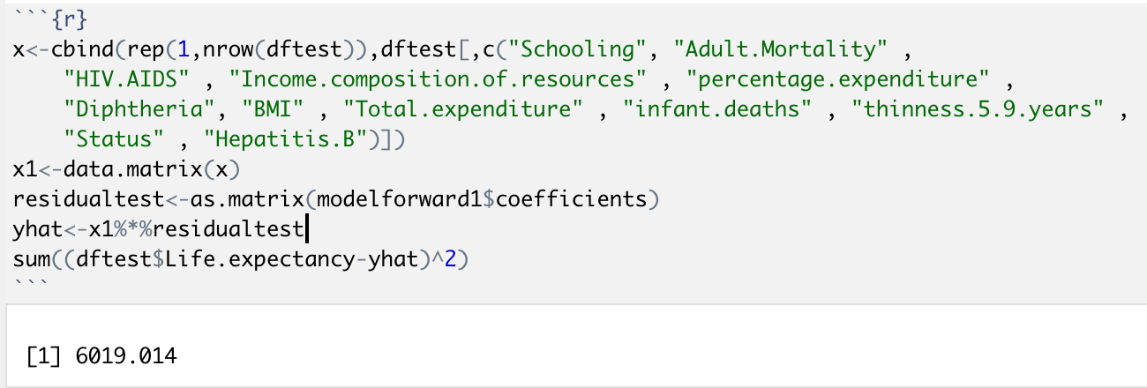
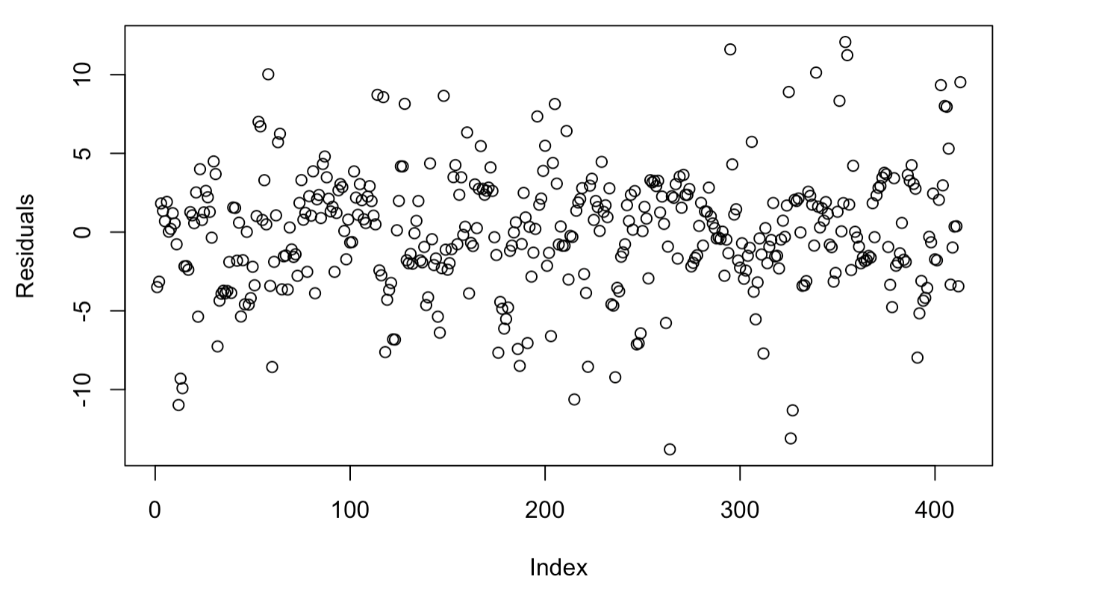
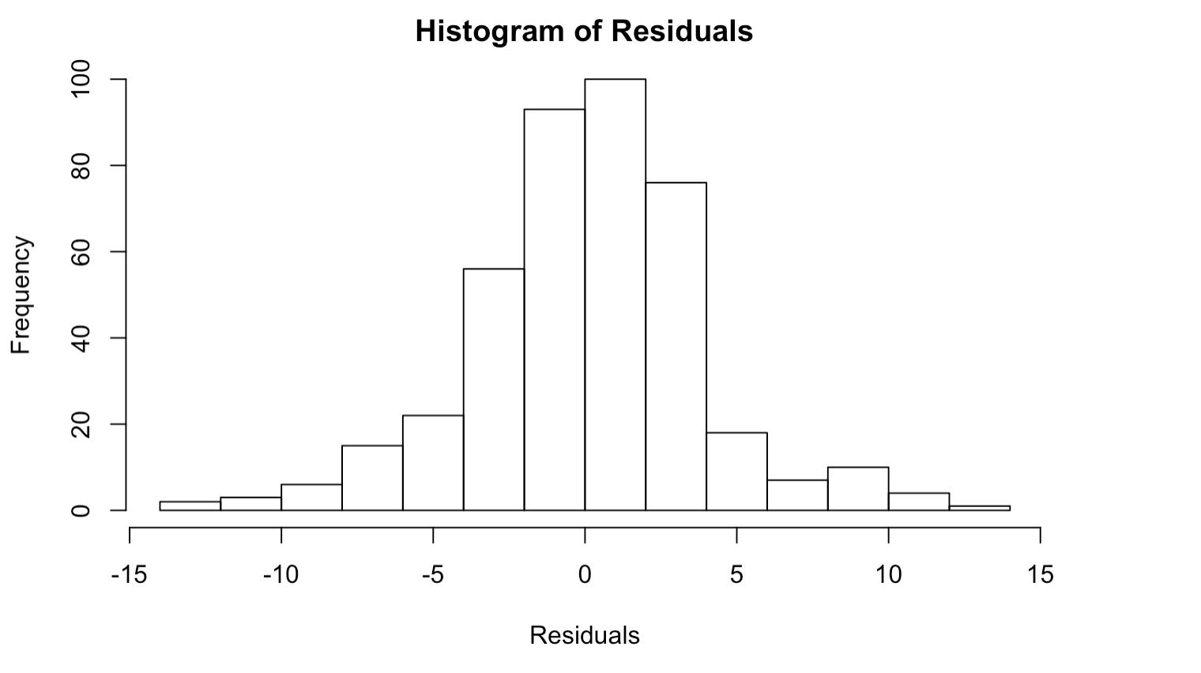
Prediction
Notes:
Use the matrix method to calculate the residual (Y- Yhat), get a loss function sum(Y- Yhat)^2. From the plot of residuals, we can find a the residuals are distributed around x=0 randomly. Also, the residuals are distributed normally. It suggests the model fits the data well.

Slide 24
Improvement
Rescale some of the predictors
Further investigation on BP test
Notes:
Some of the predictor like population has value over thirty million, but the predictor HIV.AIDS has value around 0.1. They have a large difference. They do not contribute equally to the analysis and might end up creating a bais. Therefore, population will influence the result more due to its larger value. But this doesn’t necessarily mean it is more important as a predictor.
For BP test, we have a result contradicts what we have observed in residuals versus fitted value plot. We may need further investigation on why this happens.

Slide 25
Thank you !

